Slide 1


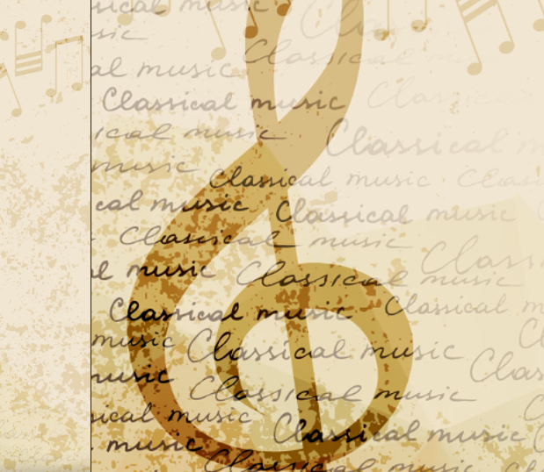


TECHSEN
“MUSIC DONE RIGHT”
Techsen
Presented By:

Slide 2
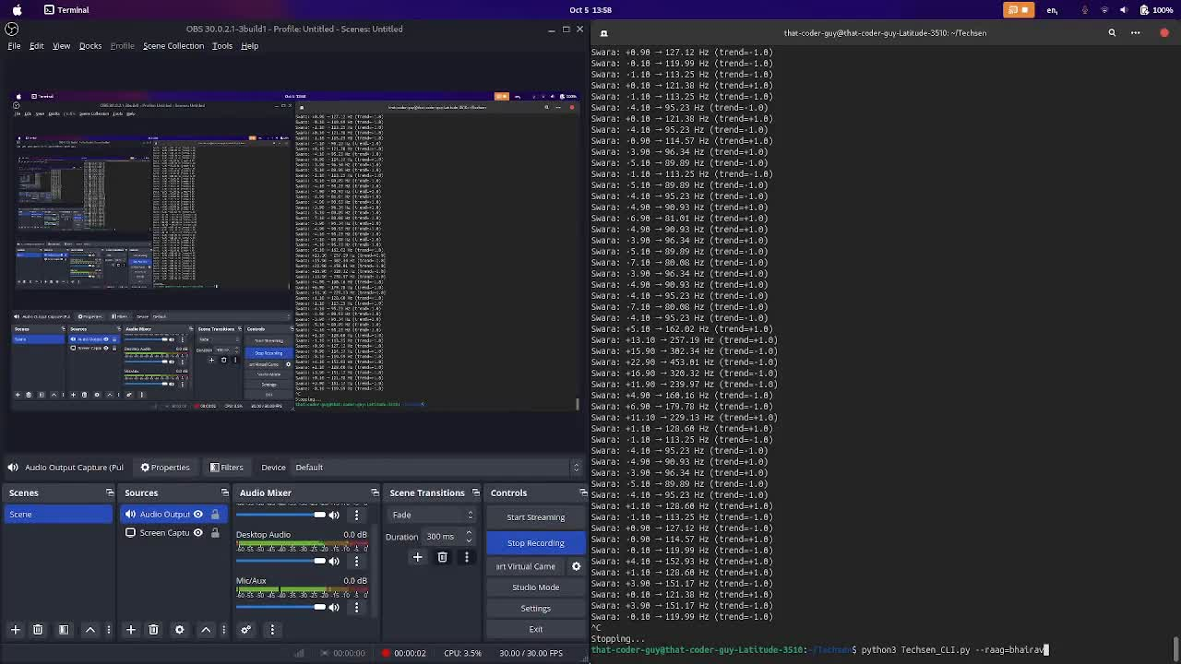

DEMO VID

Slide 3


POTENTIAL KEY USERS
Students
Music Institute
Small scale performers
Hobbyists

Slide 4
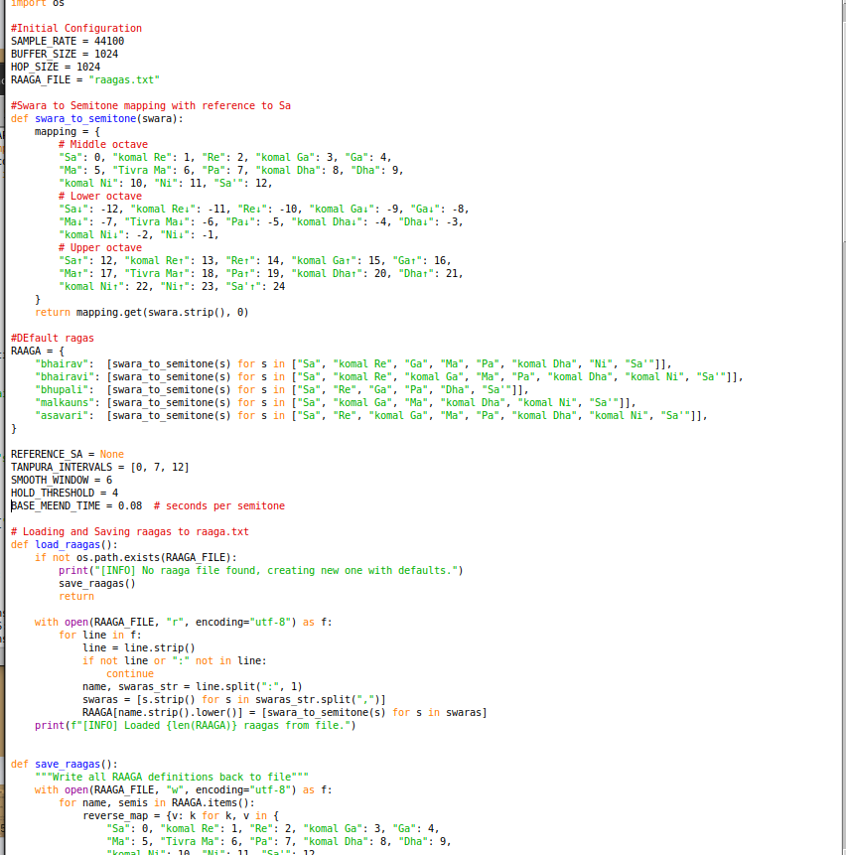
The Working Code

Slide 5



&
Assumptions
Set Backs
All Instruments are in same ragas(ras/vibe)
The lack of computational resources appropriate to the scale of the project
Machines cannot entirely grasp human art
Lack of time to dive in the deep ends of the tech, science and art behind the project
This project is just a proof of concept of a larger goal we will attempt to achieve

Slide 6
Team’s precursor knowledge
ANIMISH
Learning Hindustani Classical music for 12+ years.
Currently learning under Dr.Nagraj Rao Havaldar
AIR 1 in Google Code to Learn Appdev.
Knowledgeable in Java, C#, and Python programming, and experienced in digital music production via softwares such as LMMS and FL Studio
MANASI
ARAVIND
Skilled in Python programming, MySQL database management, and HTML web development, with a strong foundation in backend and frontend technologies.
PRANAAV
MANYA
Skilled in HTML and SQL, with a solid understanding of managing data. Eager to apply and grow these technical abilities in practical projects.
Proficient in Java, HTML, JavaScript, and Python, with hands-on experience designing user interfaces and experiences using Figma.

Slide 7
PLAN FOR ACHIEVABILITY
Our main goal was to create a tool for amateur musicians to get regular practice with background accompaniment
A further deep dive into machine learning and in general, machines trying to grasp the abstract concepts of human art
A really knowlegeable and musically excellent tool available at the tips of our fingers

Slide 8
PLAN FOR ACHIEVABILITY
Train and develop an AI for instrumental analysis that can understand and recognize various patterns and ragas
This training will provide the baseline for the object AI to predict and generate instrumentals and melodies based on prompted information
Apply and test this AI in the real world

Slide 9
What our model has achieved so far...
Techsen is so far able to play along following a lead, while observing trends and trying to predict and make glides. Its still not mature enough to analyse the “chalan” of different raagas(unique styles) and play appropriately. Some of Techsen’s mistakes end up sounding extremely artistic, way beyond the musical maturity of the script, but other times it does not match the emotion being conveyed. Techsen, in its current state, is an excellent for ametuers to practice with, still needing some brushing up before it can perform on a stage infront of music patrons.

